Slide 1
DIGITAL MARKETING PRESENTATION
Name: I Prasanti
sic: 20BCEA56

Slide 2
OVERVIEW
DIGITAL AUDIT
SEO AUDIT
MY DIGITAL PROPERTY
GOOGLE ADS
SOCIAL MEDIA
CONTENT CALENDAR
TARGETS

Slide 3
DIGITAL AUDIT

Slide 4
Target Audience Analysis
NAME | DARPAN FURNISING
LOCATION | Hyderabad
GOALS | Sell quality furniture with a lower price and greater benefits and services to customers.
QUALITY | High quality & Modern Designs
CUSTOMER TYPE | People of low to medium range of earning
GENDER | Both Male and Female
AUDIENCE TYPE | 1.Young and cost-conscious customers 2.Young adults , students, adults. 3.Budget conscious families
METHOD OF SALES | 1. Physical store 2. E-Commerce
CHALLENGES | 1. No official blog page. 2. Inter-state transporting is not applicable for all goods
WAYS TO OVERCOME CHALLENGES | 1.Creating an official blog page

Slide 5
Sample Of Audit Of Local Business:

Slide 6
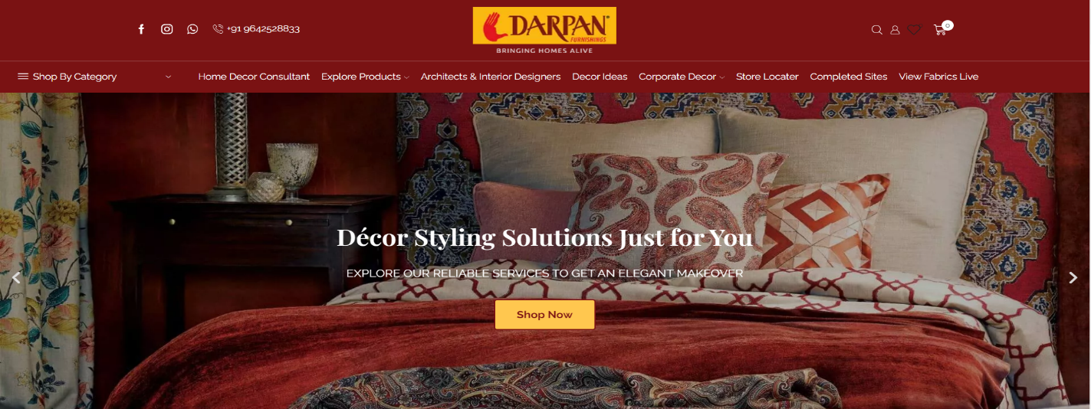
Darpan Furnishing
Website: ( https://darpanfurnishings.com/ )
URL Structure: Above 150 special characters out of 380
Broken Links: More than 12.
Page Load Time: 8 seconds.
Domain Age: 15 years 11 months 4 days.

Slide 7
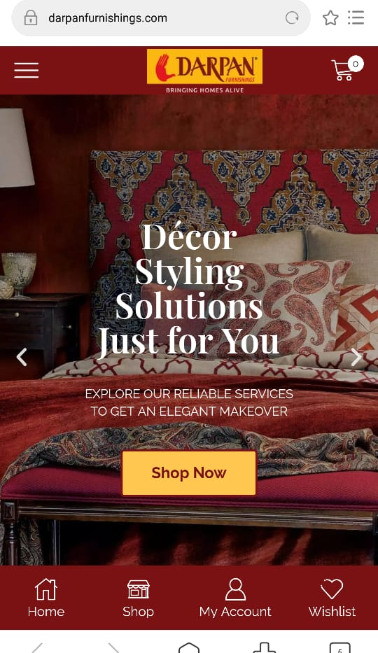
BROWSER RESPONSIVENESS
This can be accessed from:
Google Chrome
Internet Explorer
Mozilla Firefox
DEVICE RESPONSIVENESS
This can be easily accessed from devices like.
Desktop
Redmi Phone
iPhone
Plagiarism Issues: 100% original content.
Missing Content: None

Slide 8
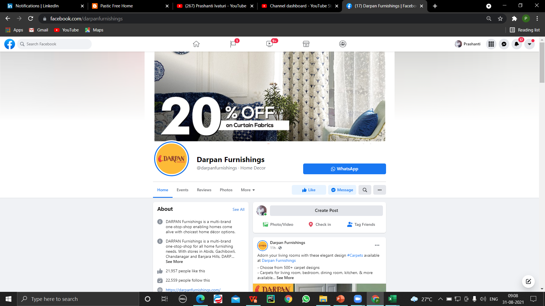
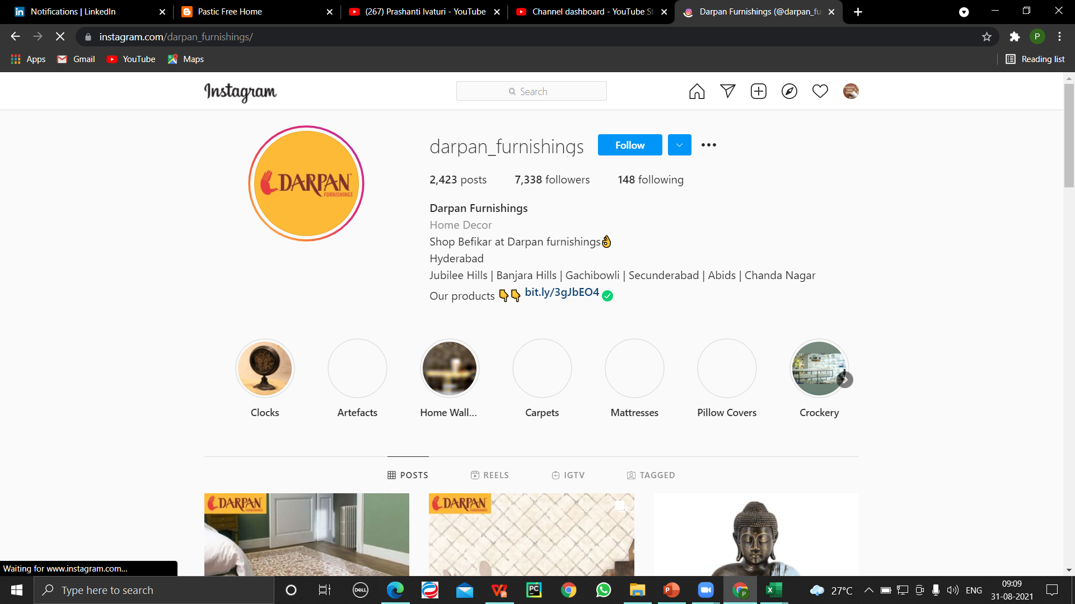
SOCIAL MEDIA PRESENCE

Slide 9
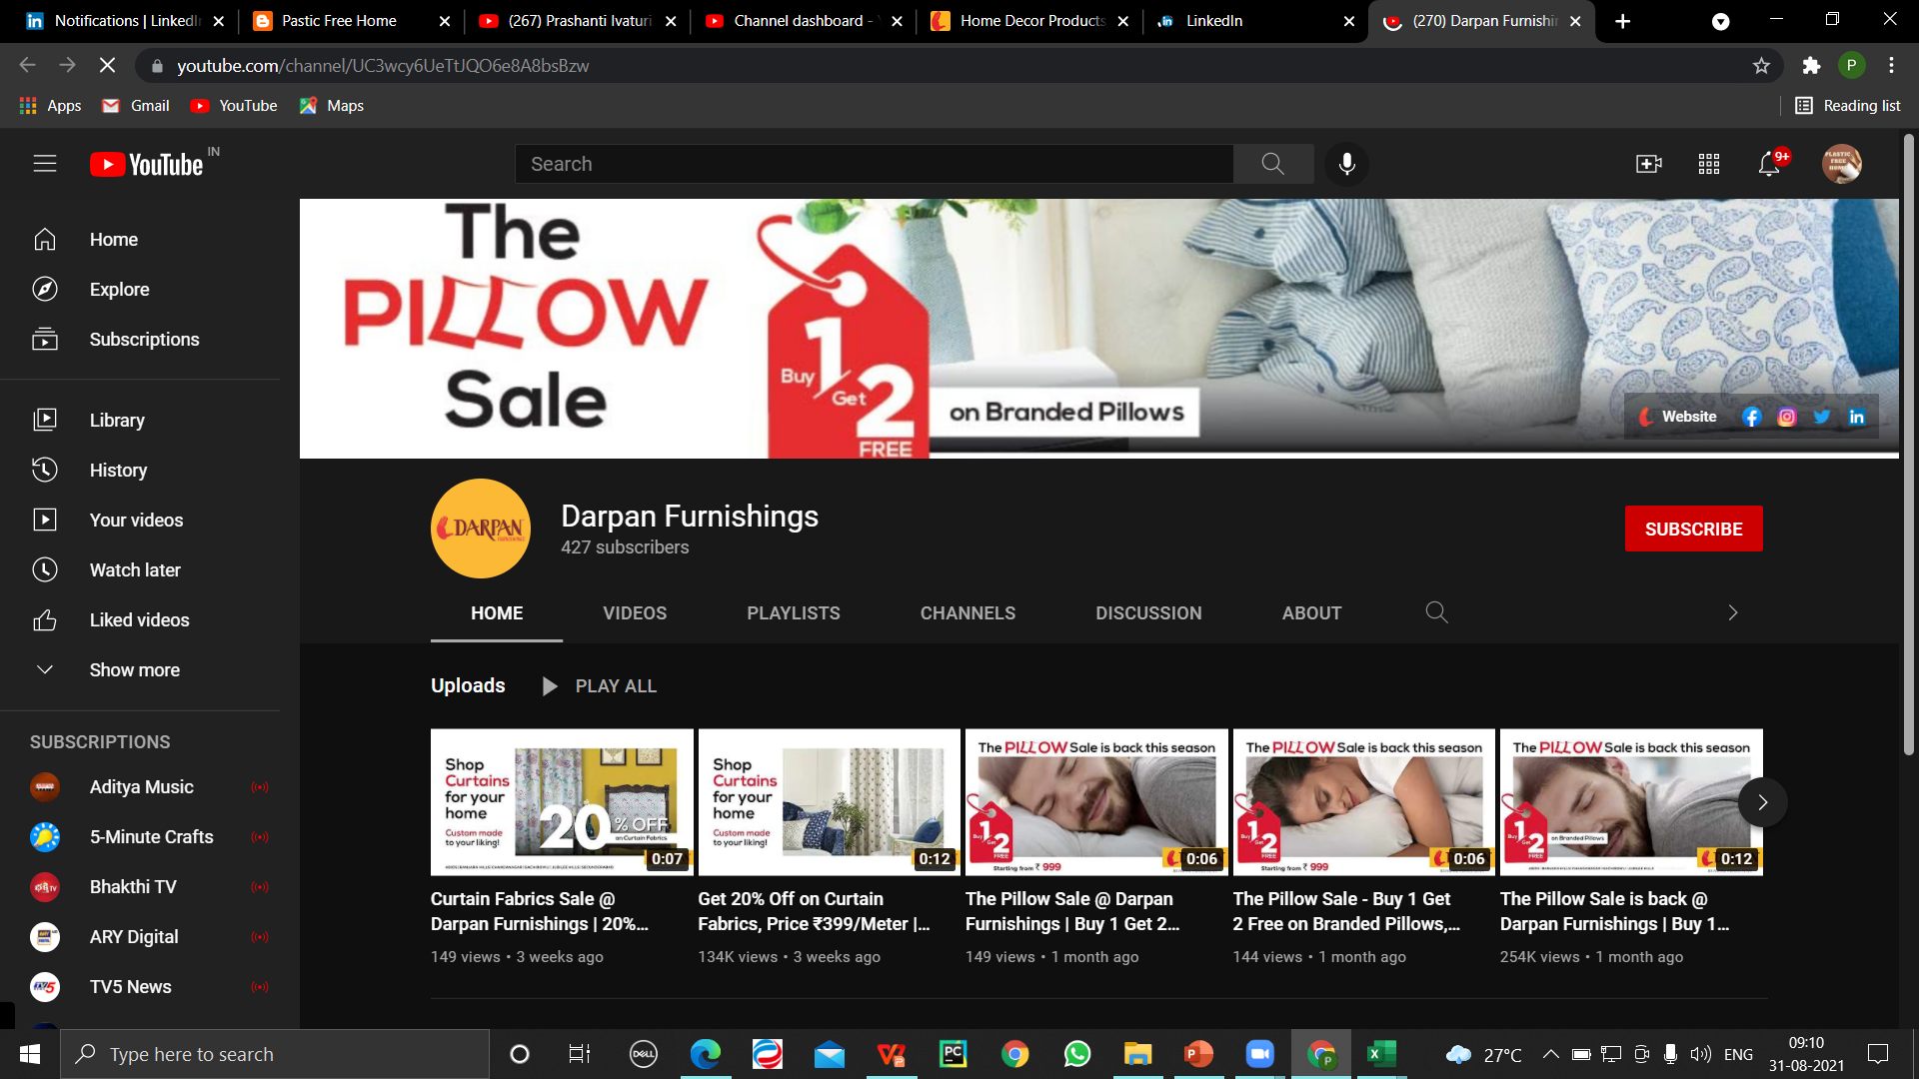
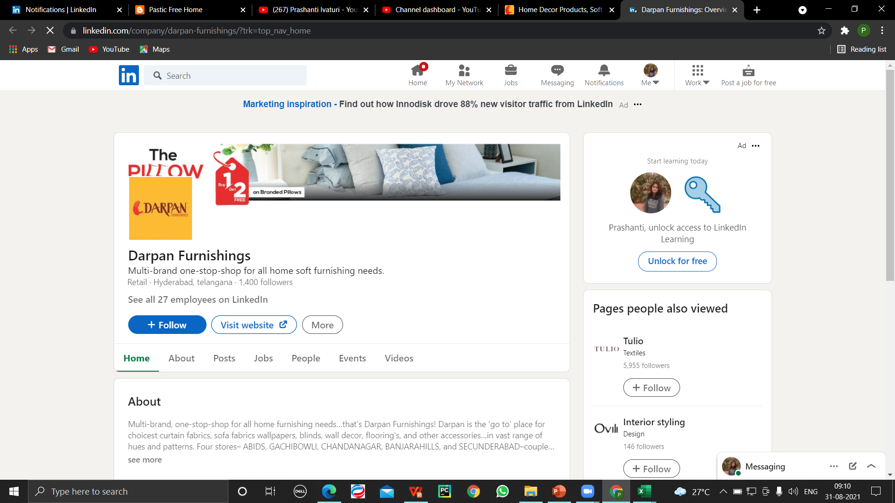

Slide 10
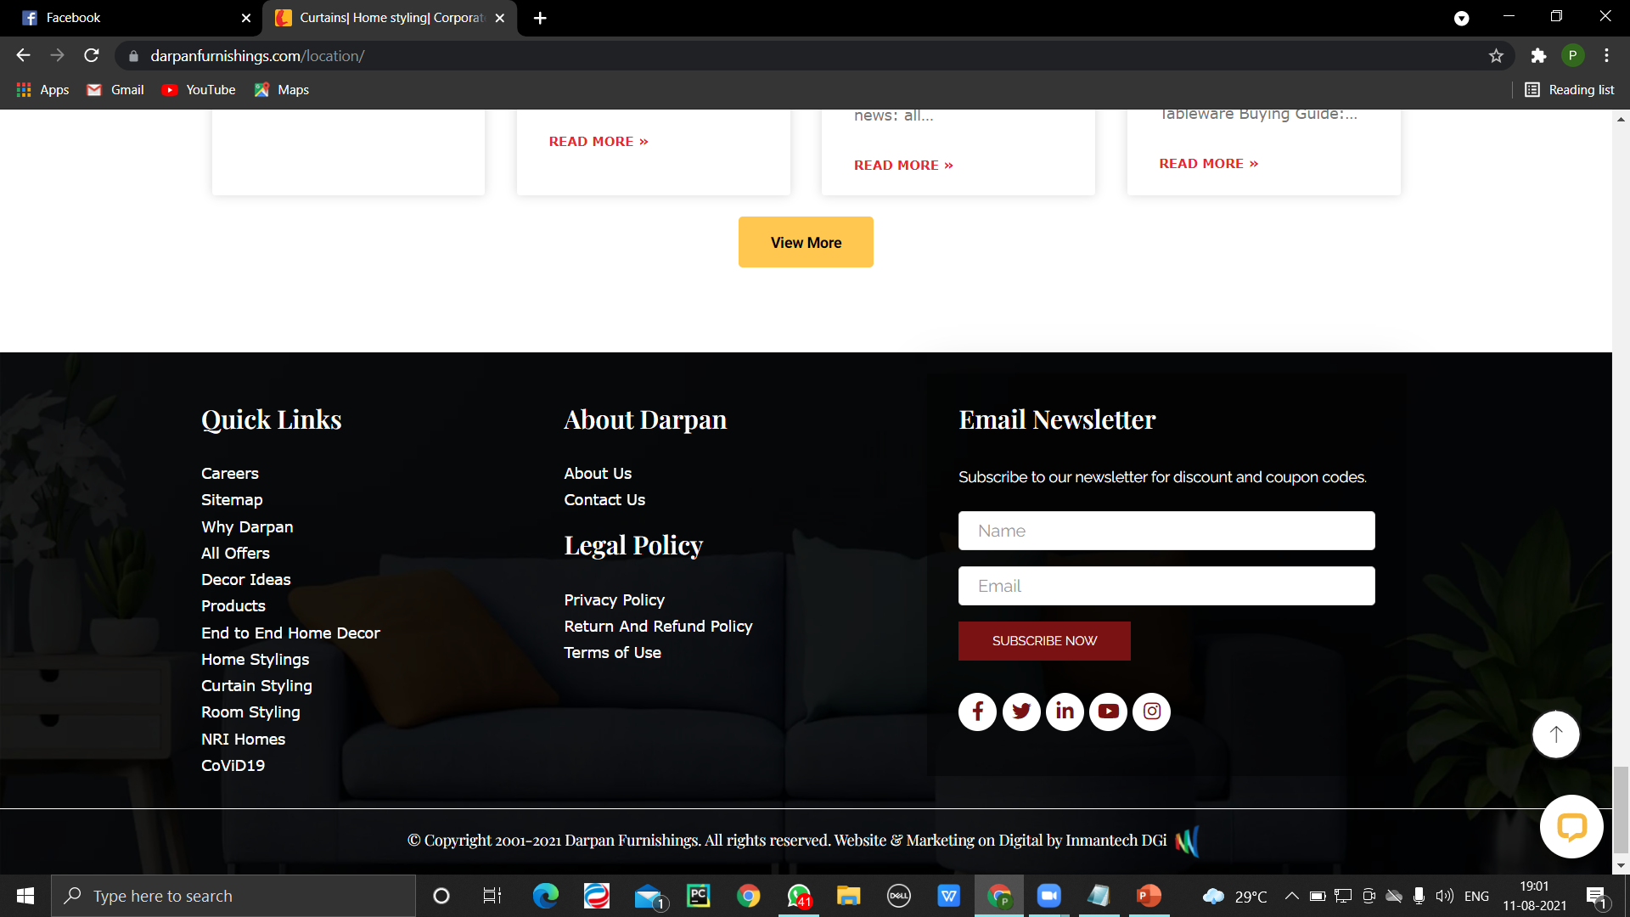
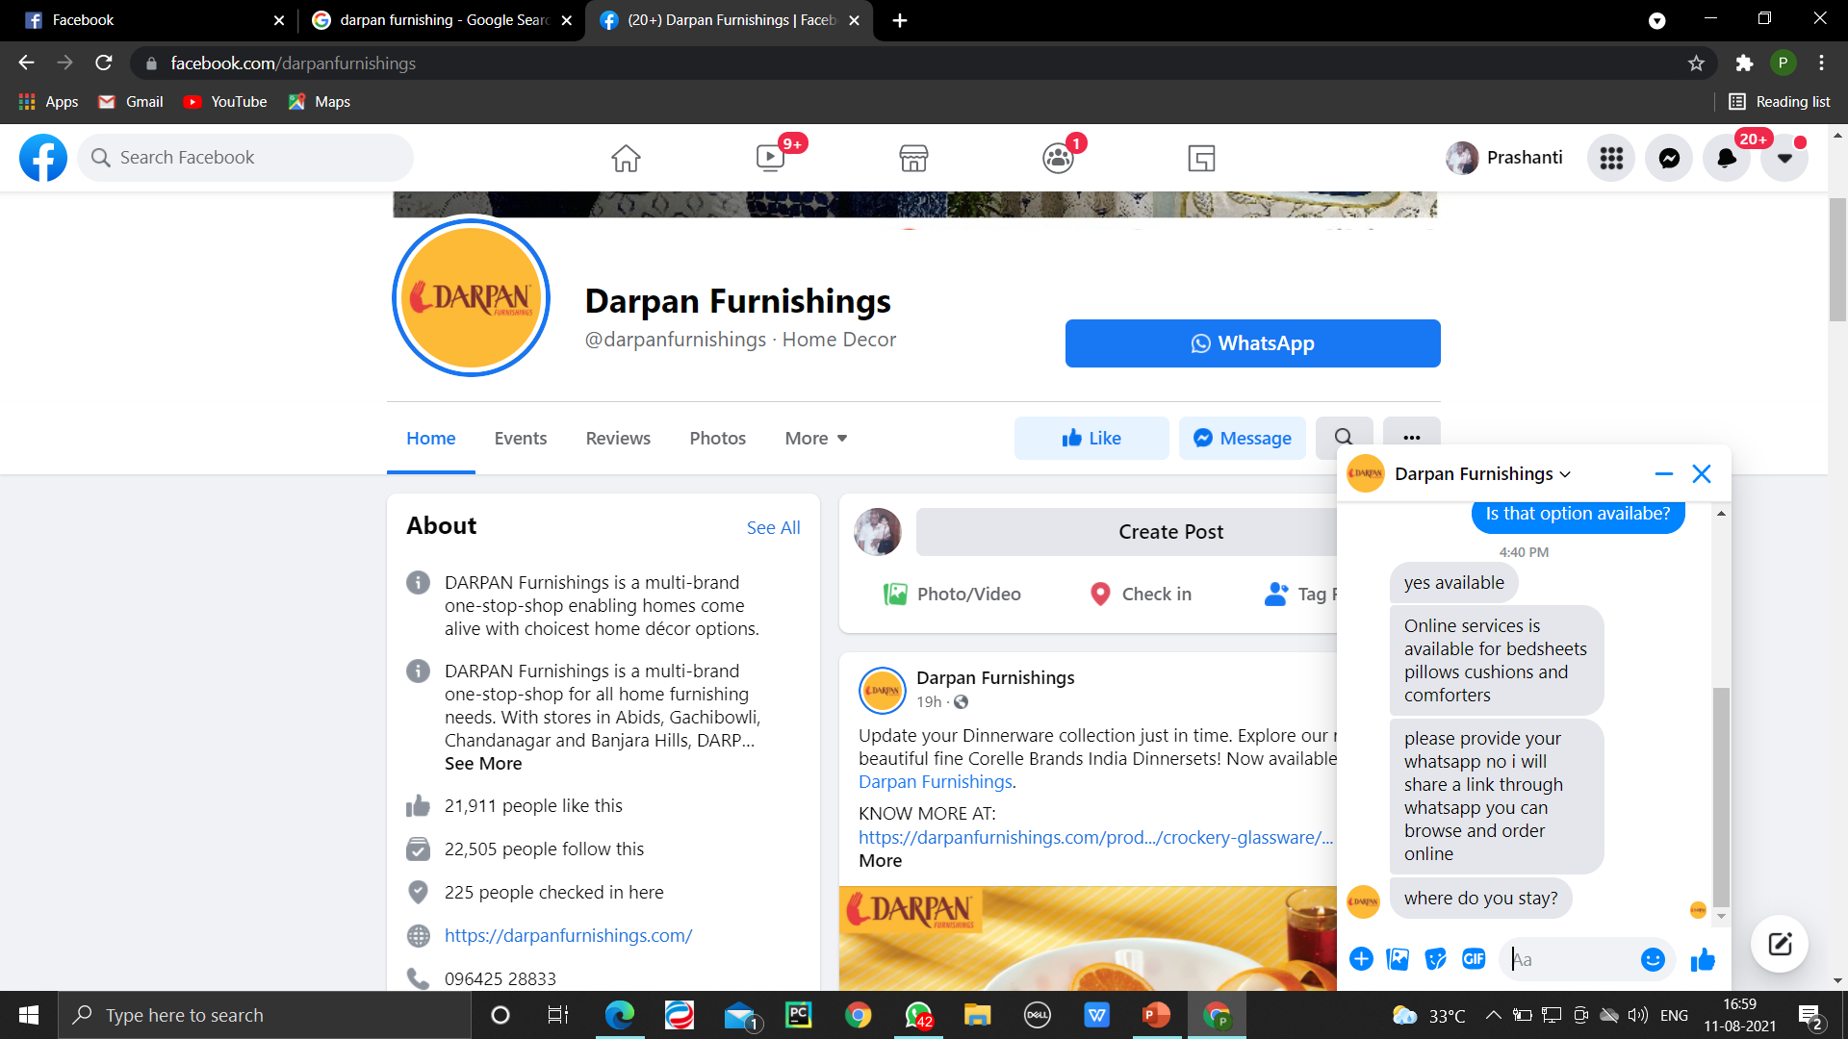
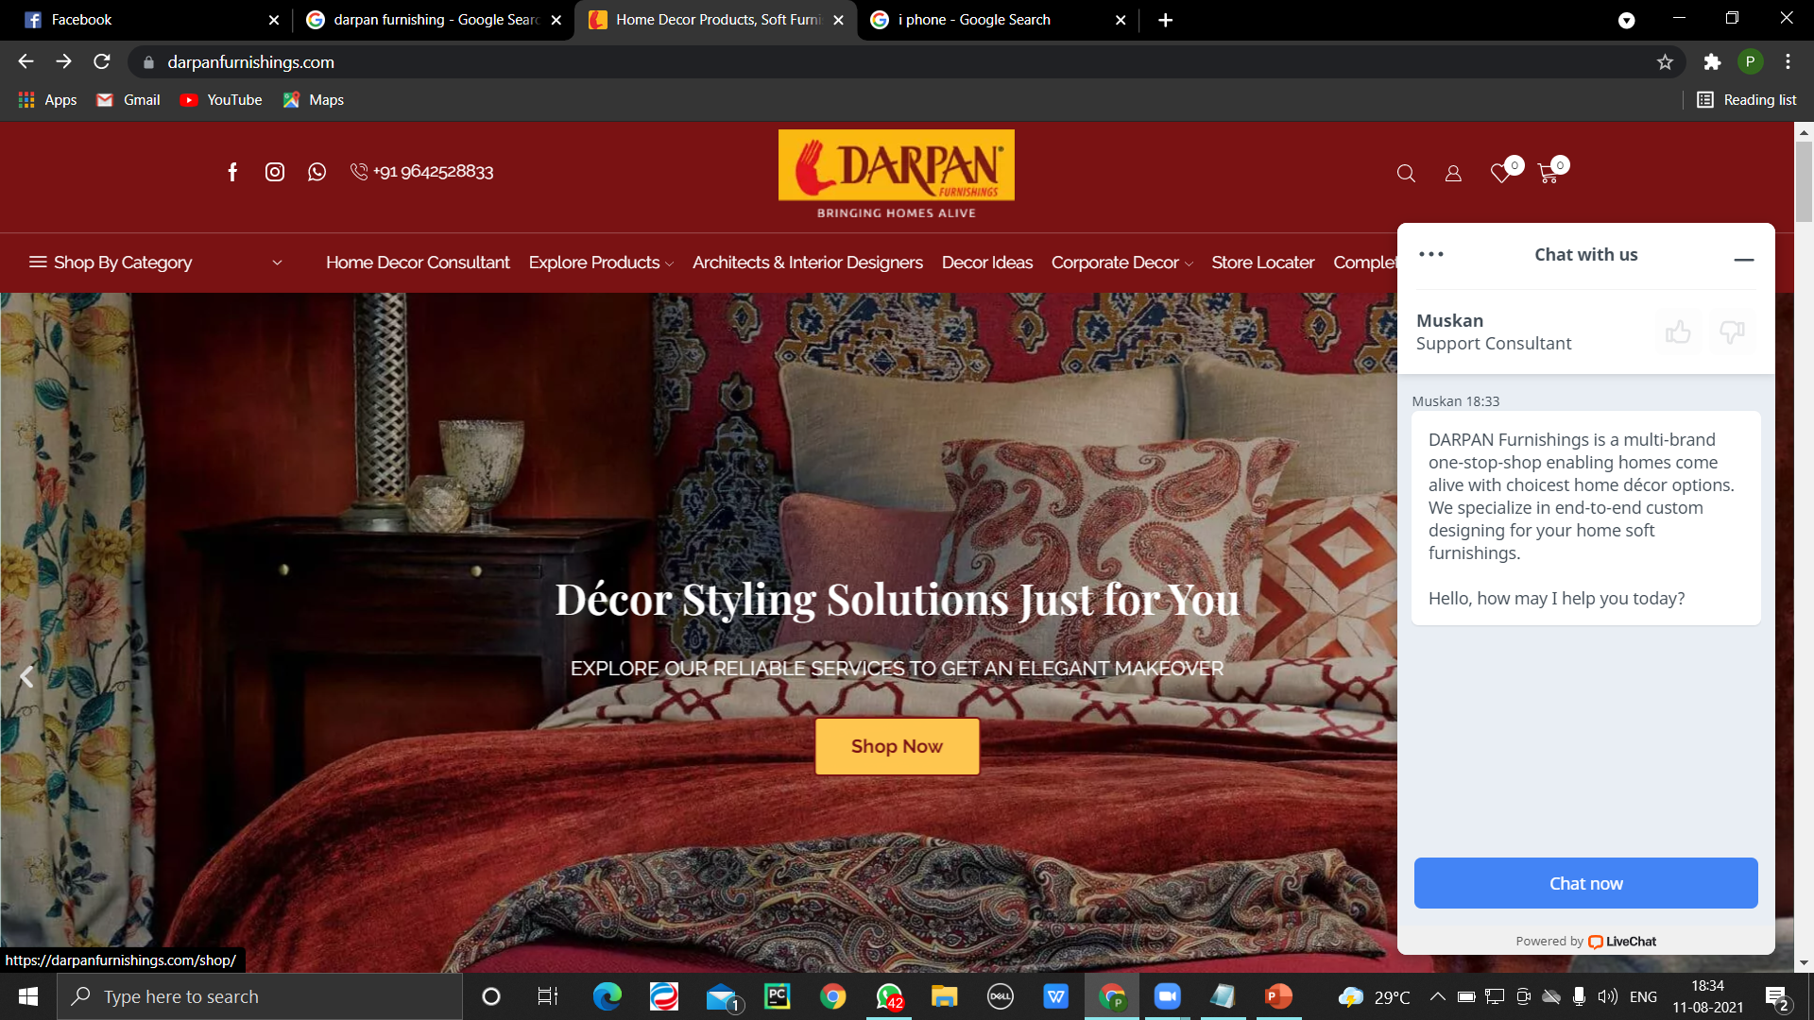
CALL TO ACTION

Slide 11
RECOMMENDATIONS
Check broken links.
In case of webpage I have no recommendations from my side, they have a good user interface with proper call to actions.

Slide 12
SEO AUDIT

Slide 13
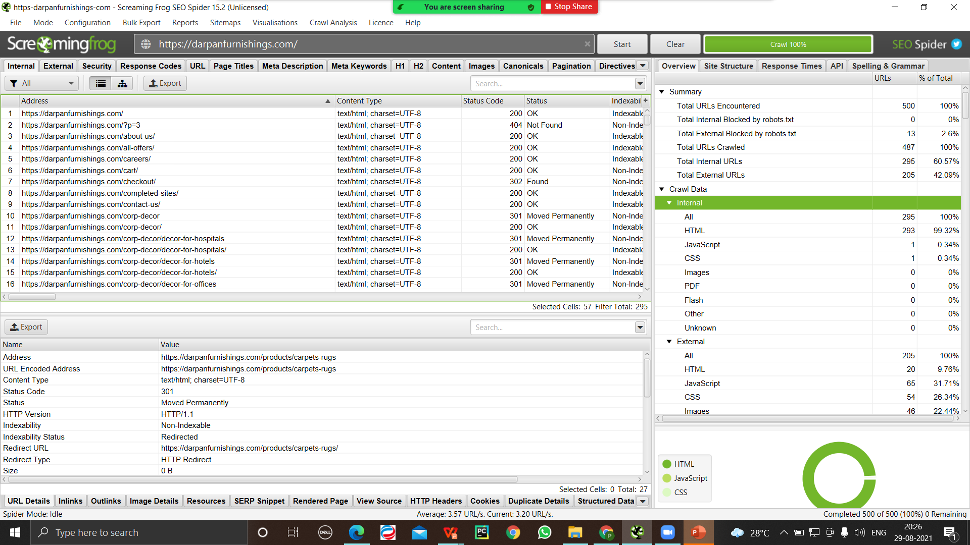
Screaming Frog SEO (screenshot) (

Slide 14
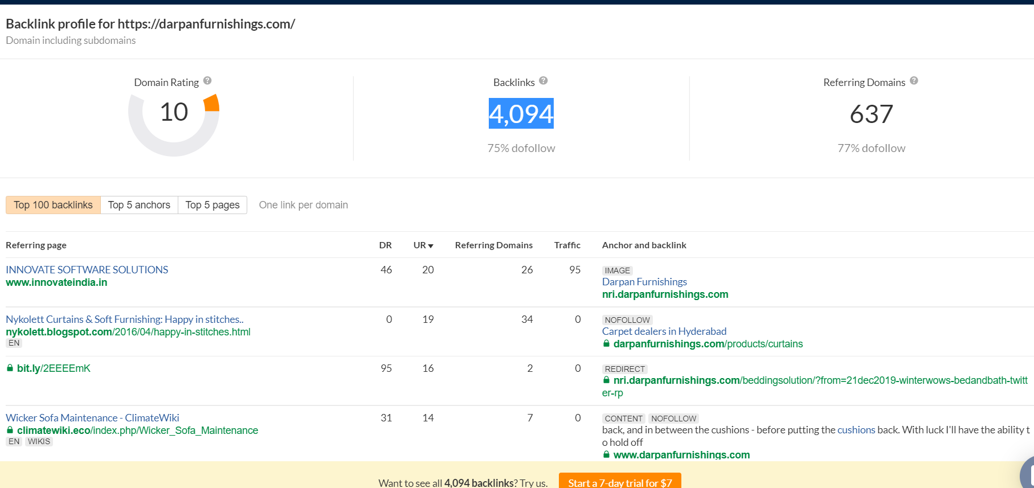
Backlinks

Slide 15
RECOMMENDATIONS
Website has images that are not in appropriate size and thus it takes time to load.
Have large layouts shifts which disturbs image loading and even waste cellular data.

Slide 16
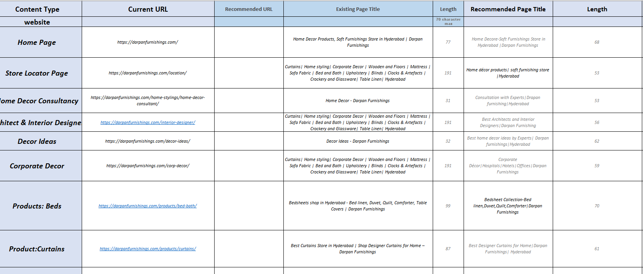
RECOMMENDATIONS

Slide 17
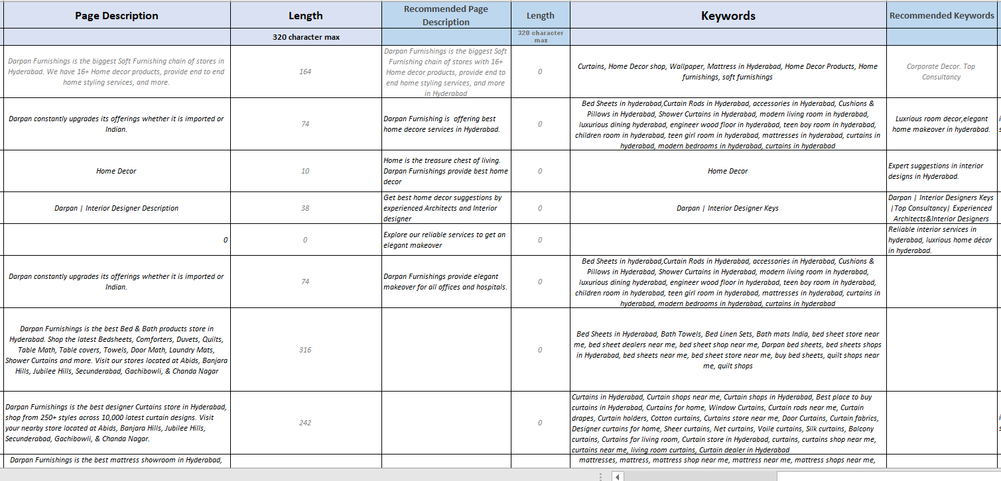

Slide 18
MY DIGITAL PROPERTY

Slide 19
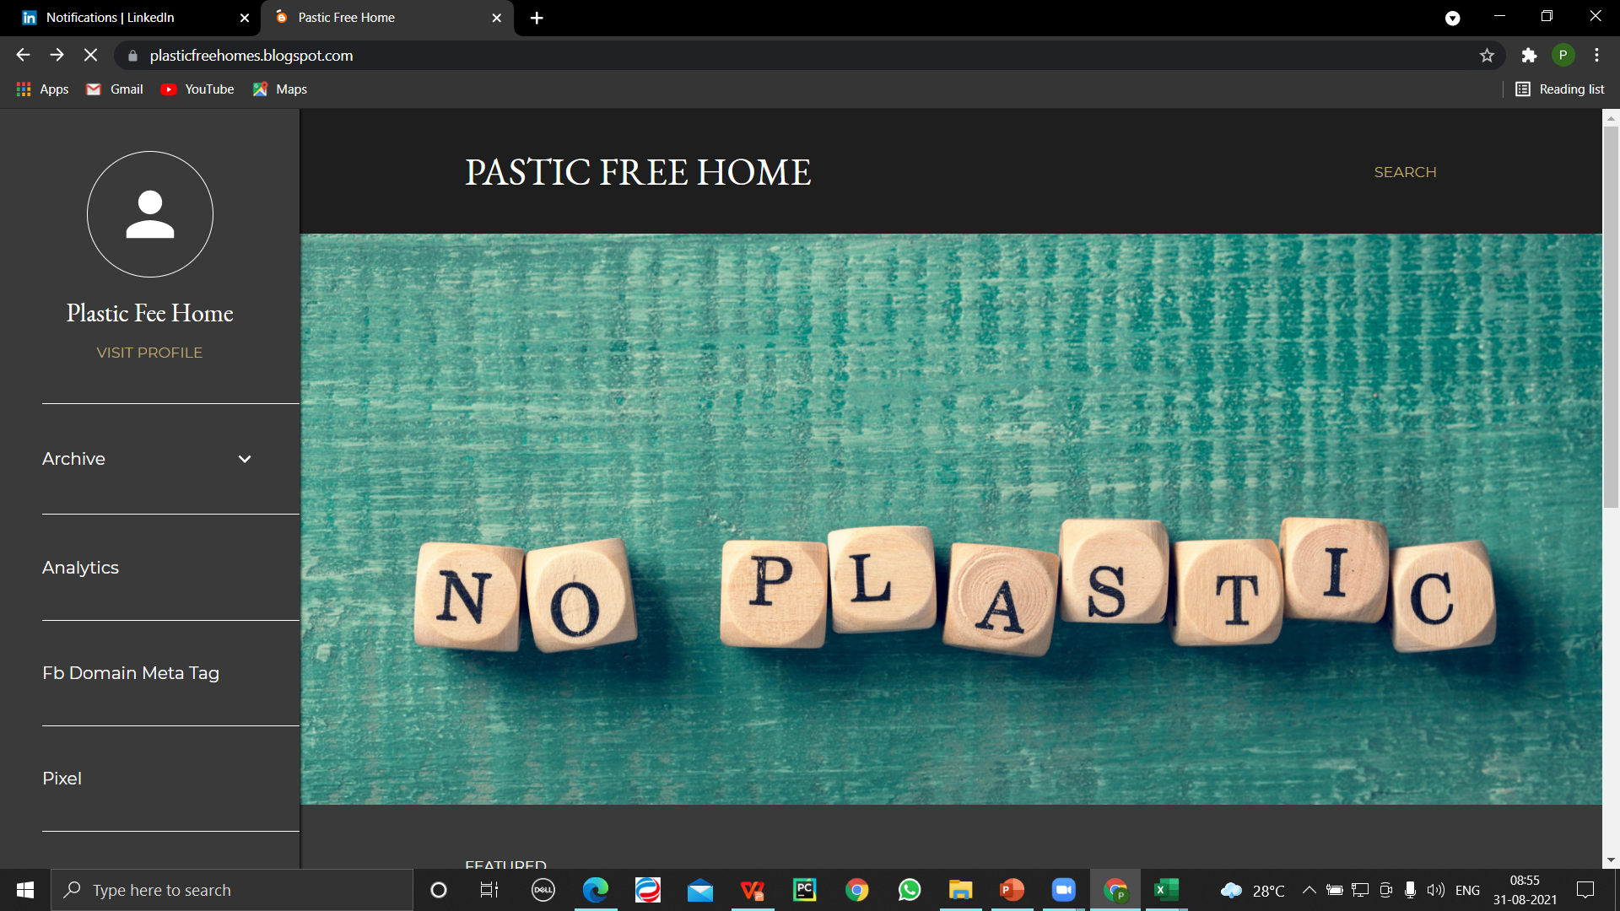
BLOG (https://plasticfreehomes.blogspot.com/)

Slide 20
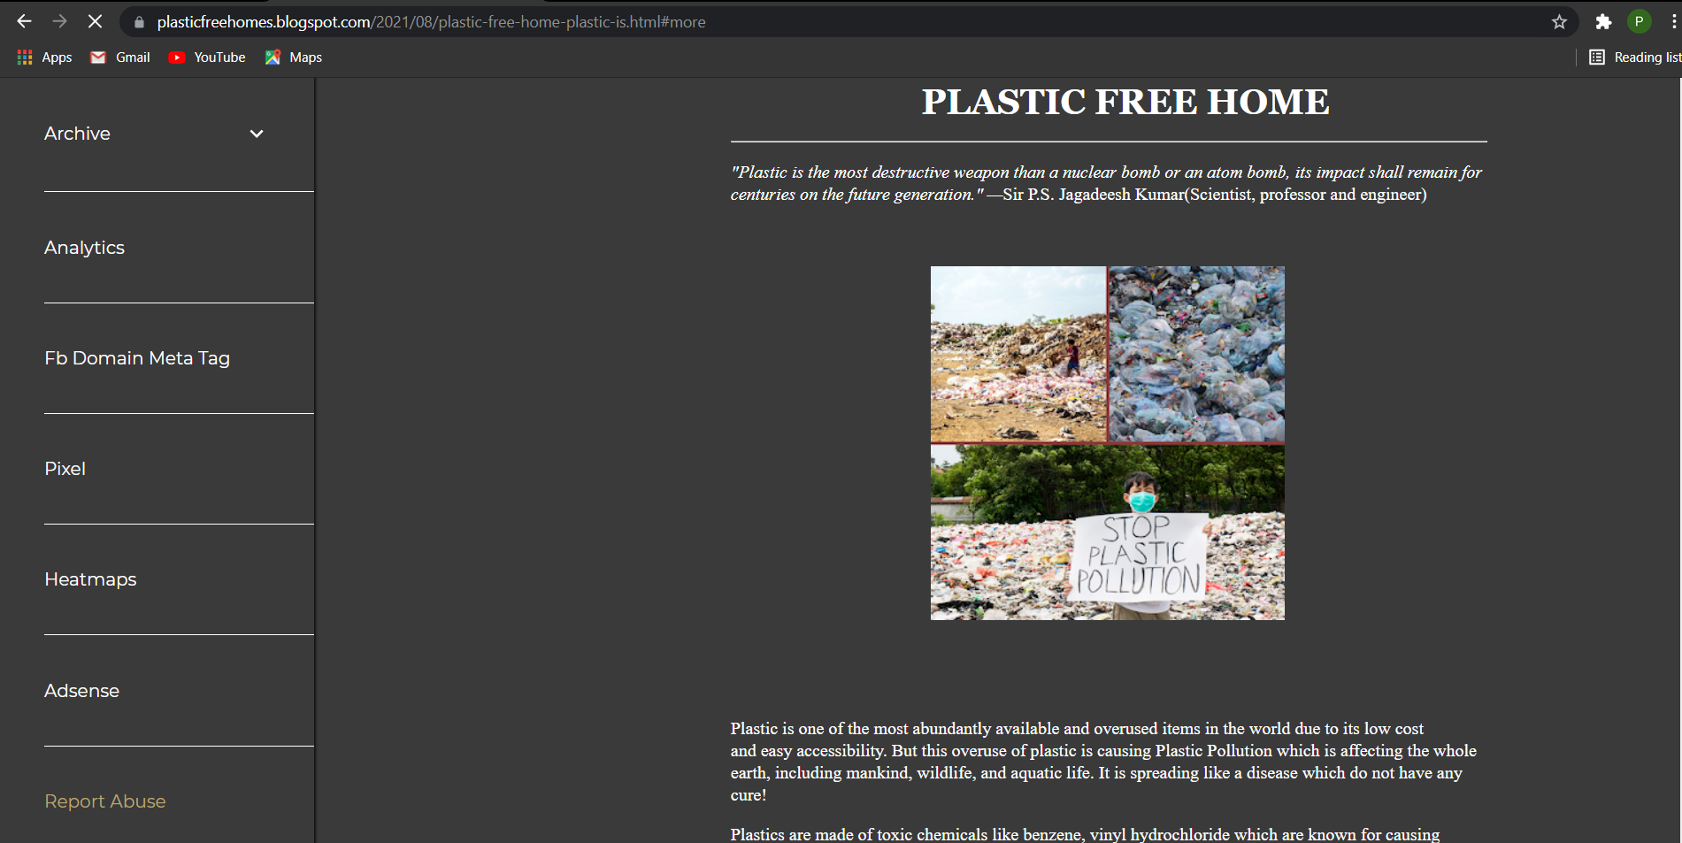

Slide 21
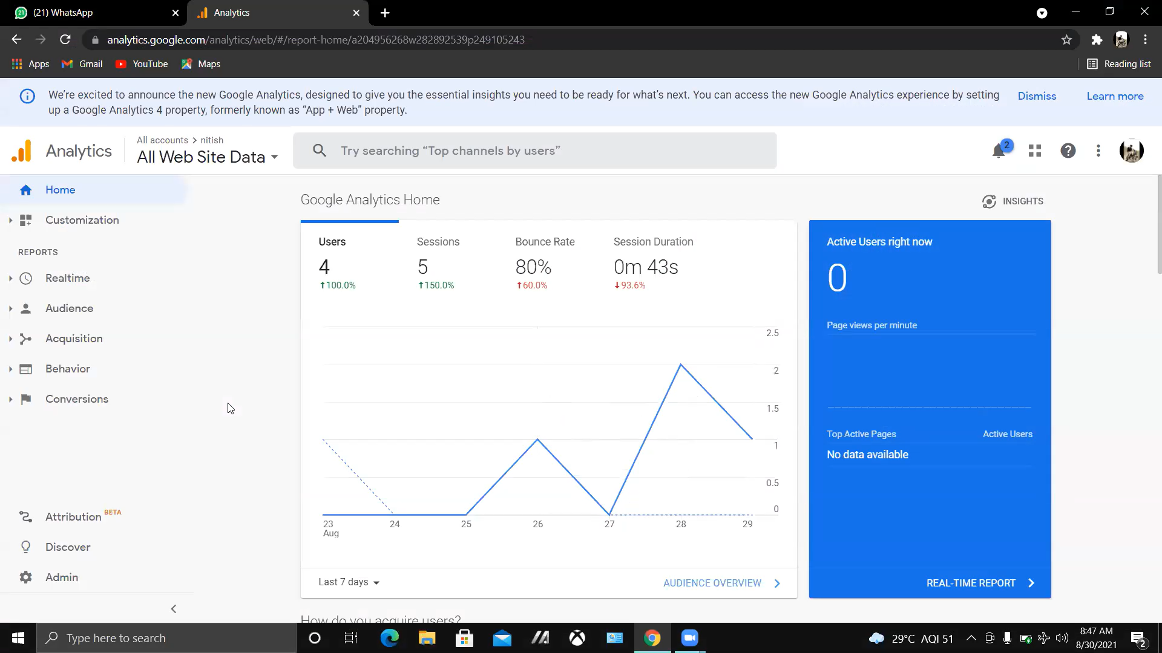
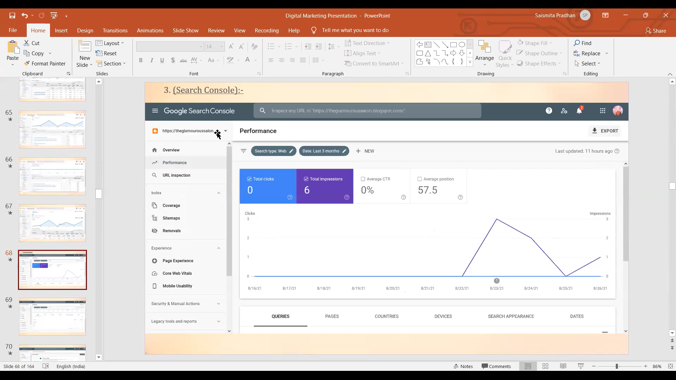
Analytics
Google Search Console

Slide 22
GOOGLE ADS

Slide 23
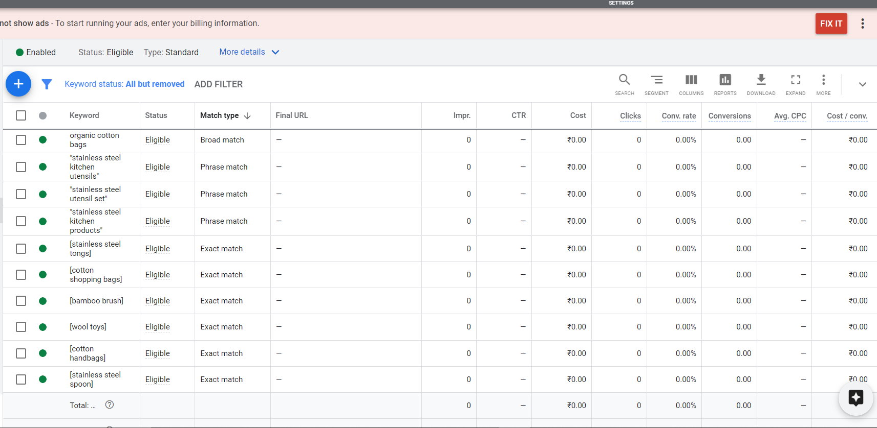
KEYWORDS (Screenshot)

Slide 24
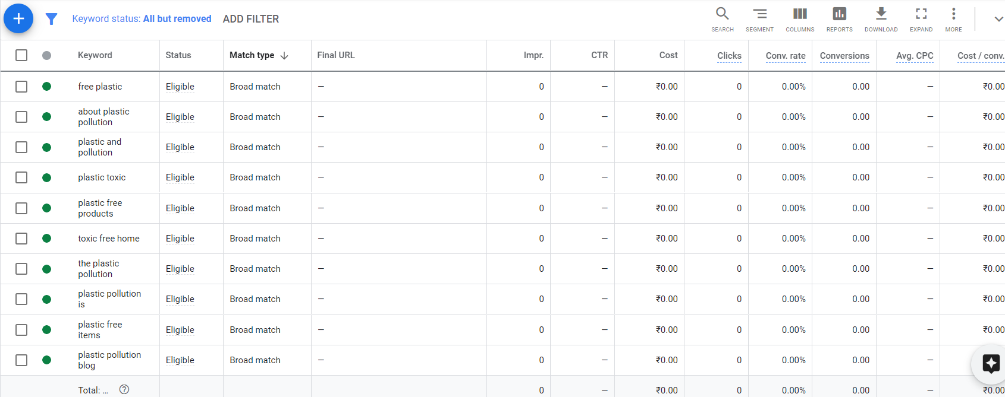
Keywords..

Slide 25
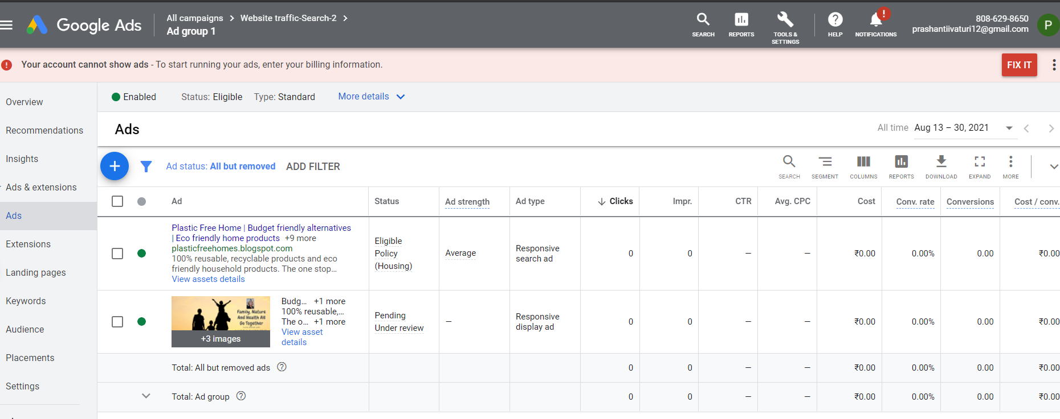
AD COPIES

Slide 26
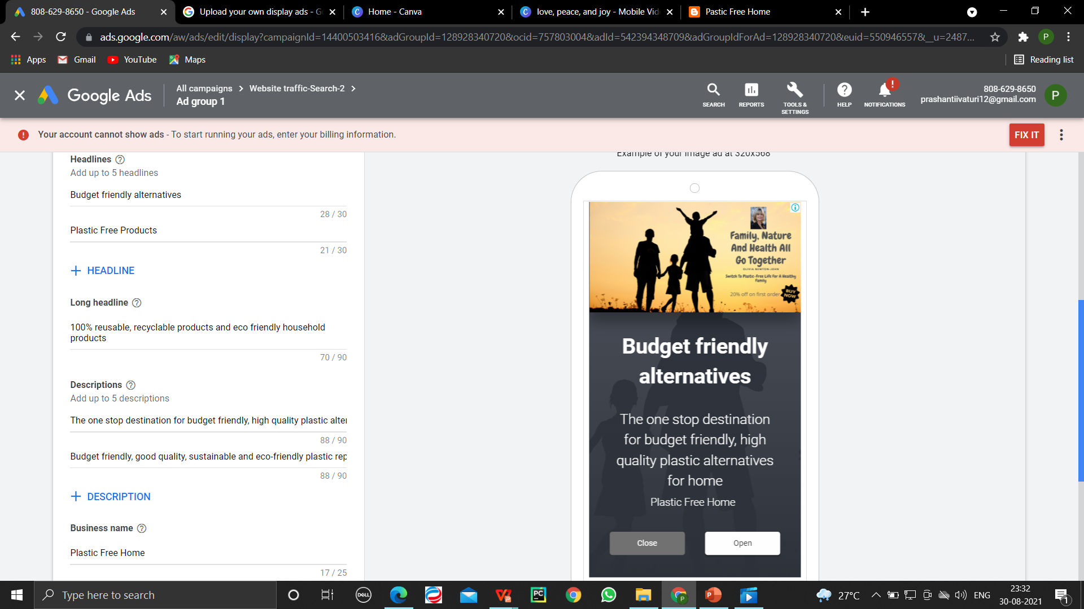

Slide 27
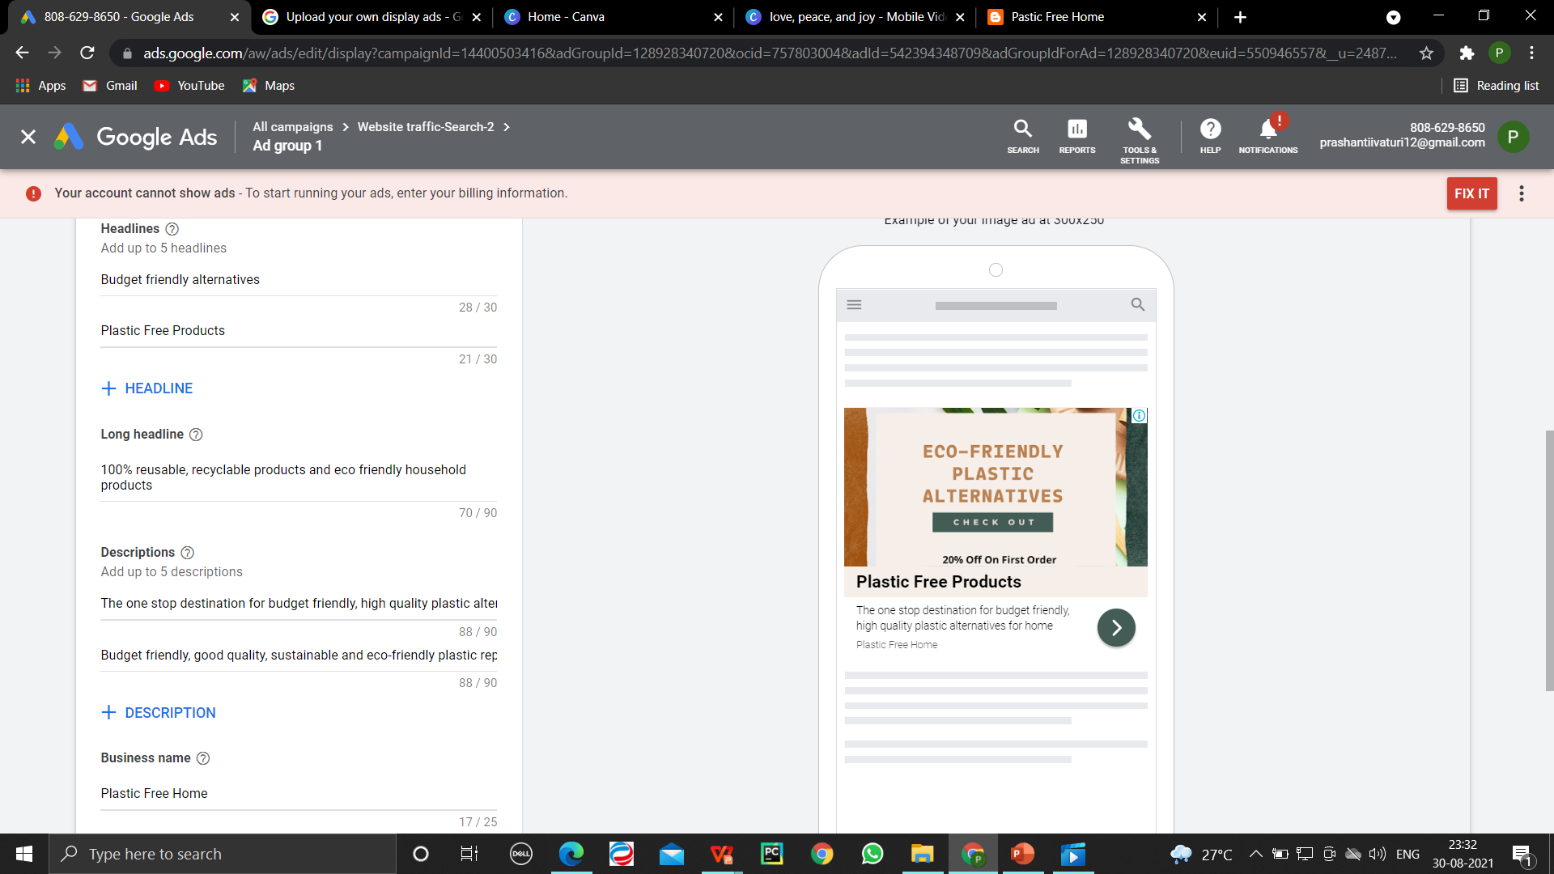
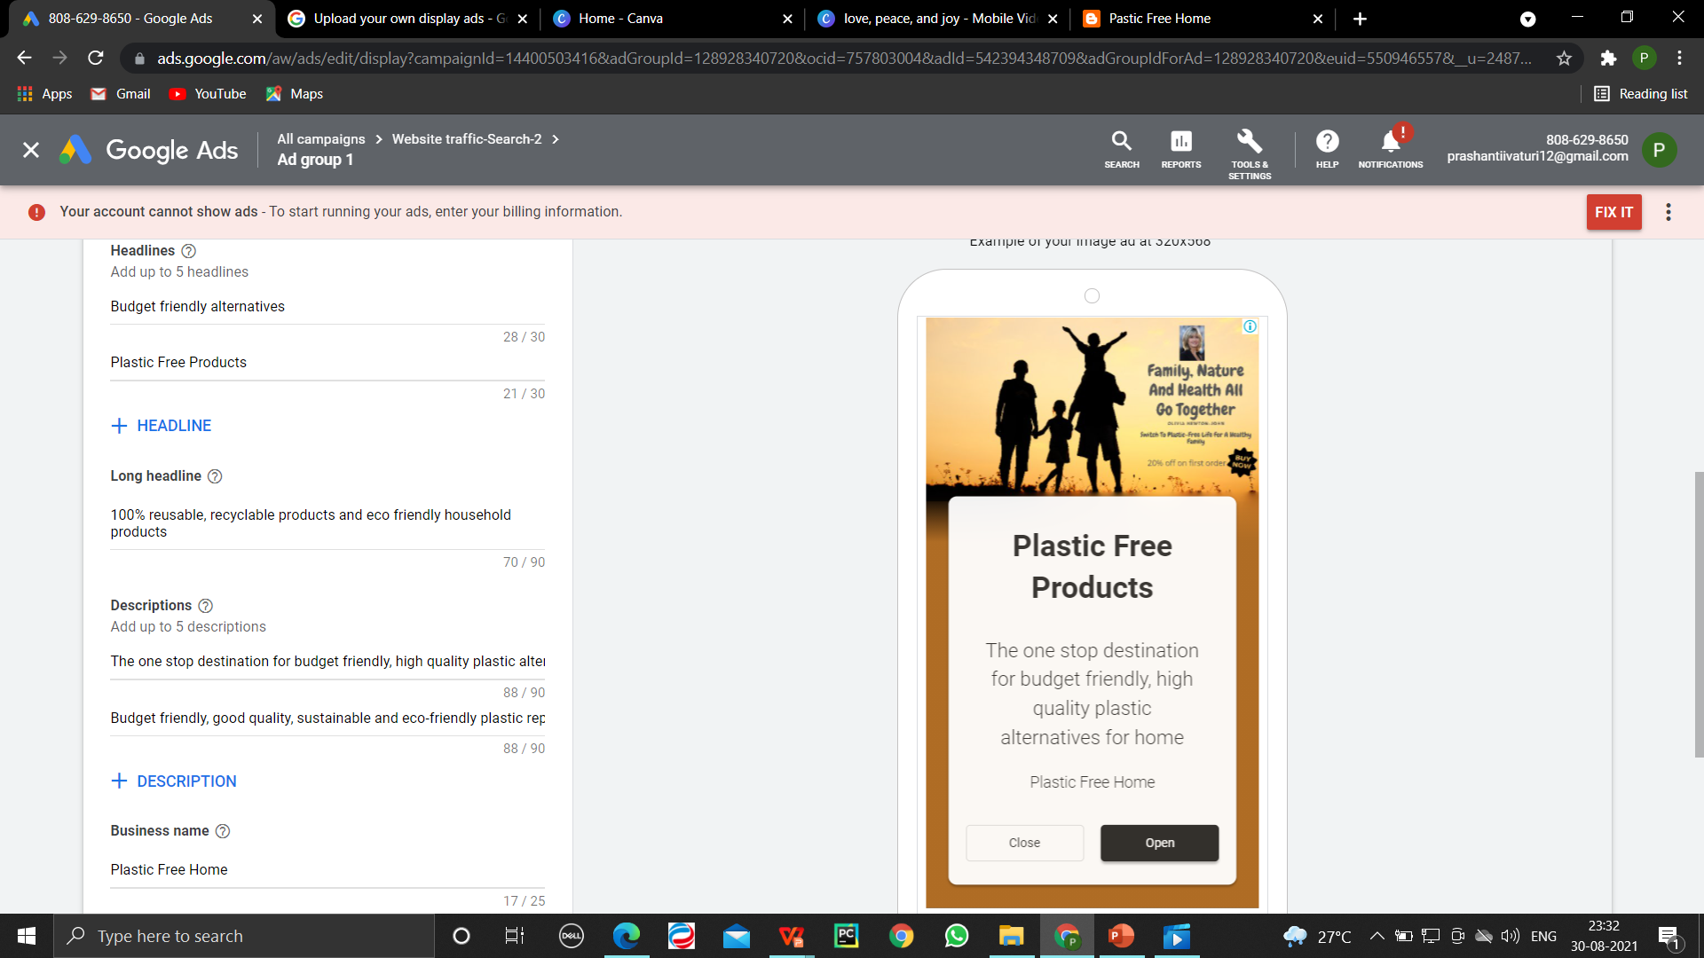

Slide 28
SOCIAL MEDIA

Slide 29
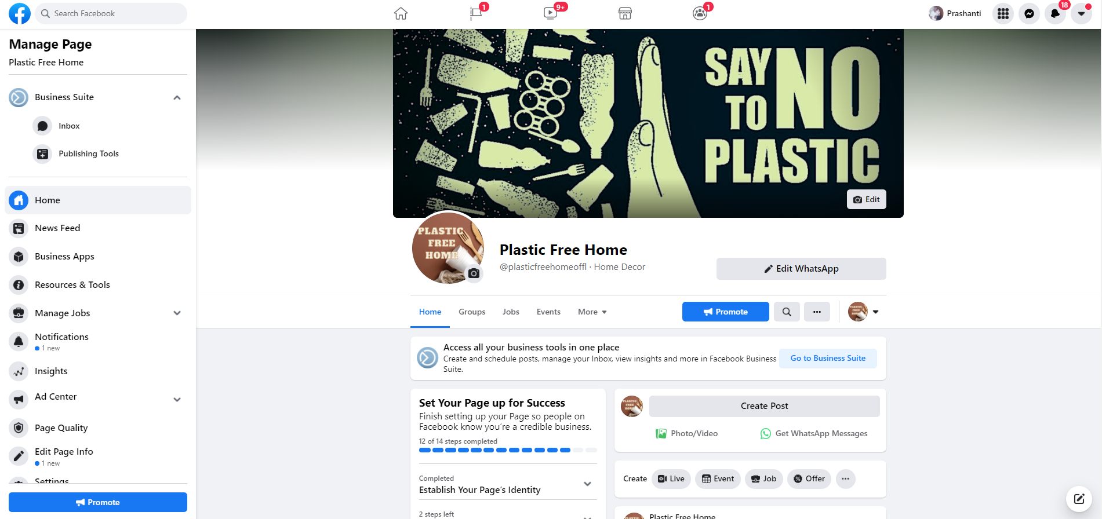
1.FACEBOOK (https://www.facebook.com/plasticfreehomeoffl/)

Slide 30
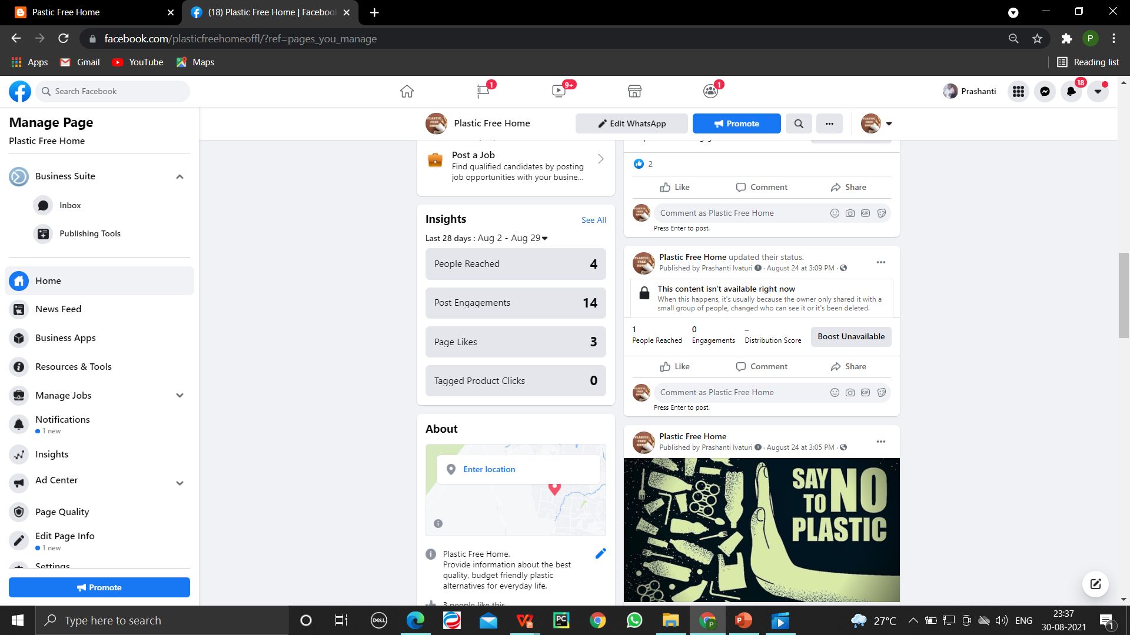
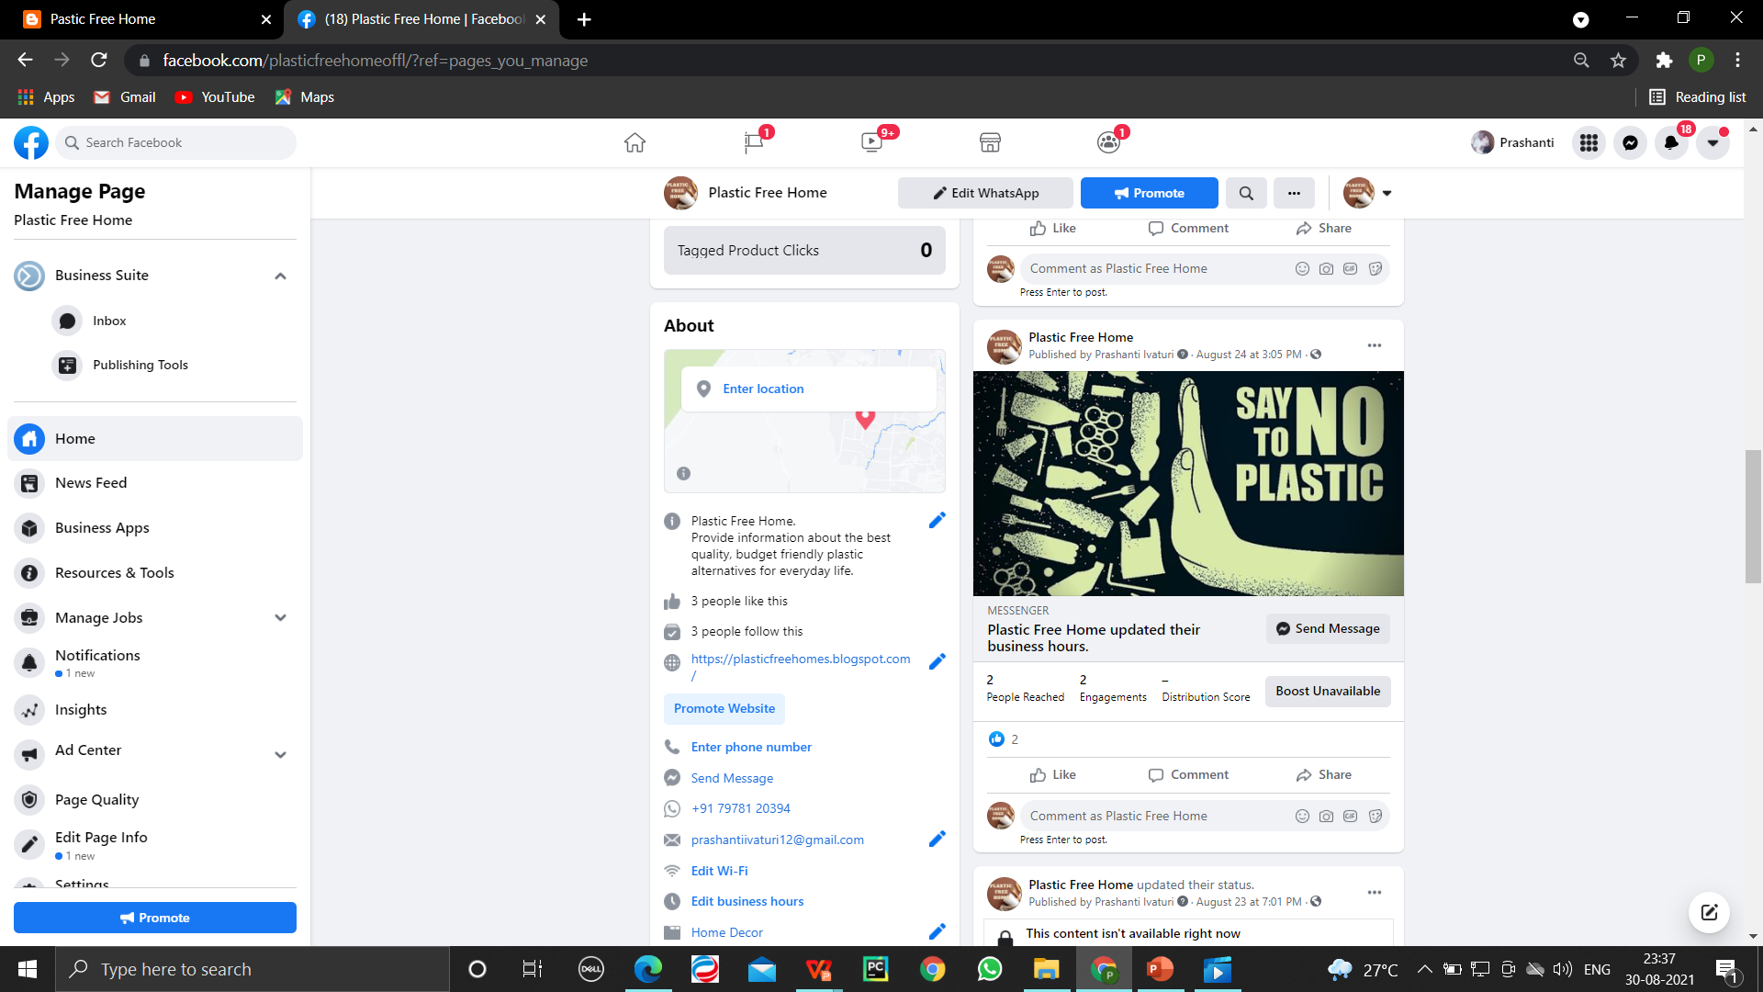

Slide 31
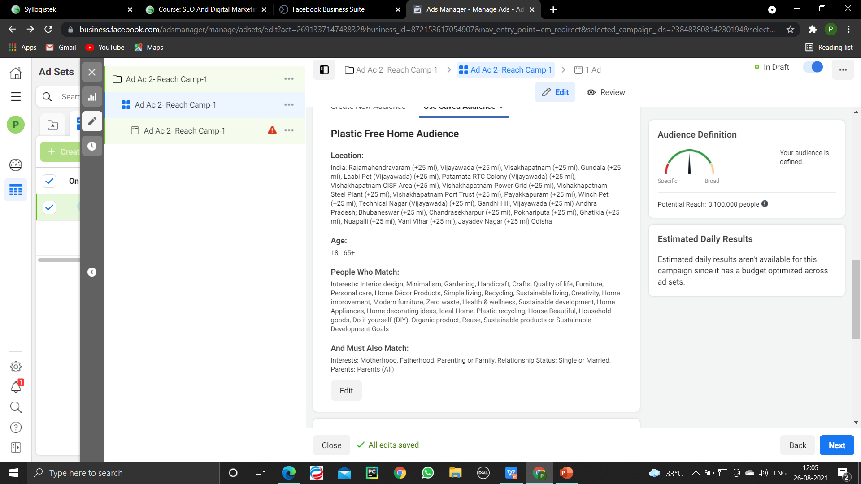
FACEBOOK CAMPAIGN

Slide 32
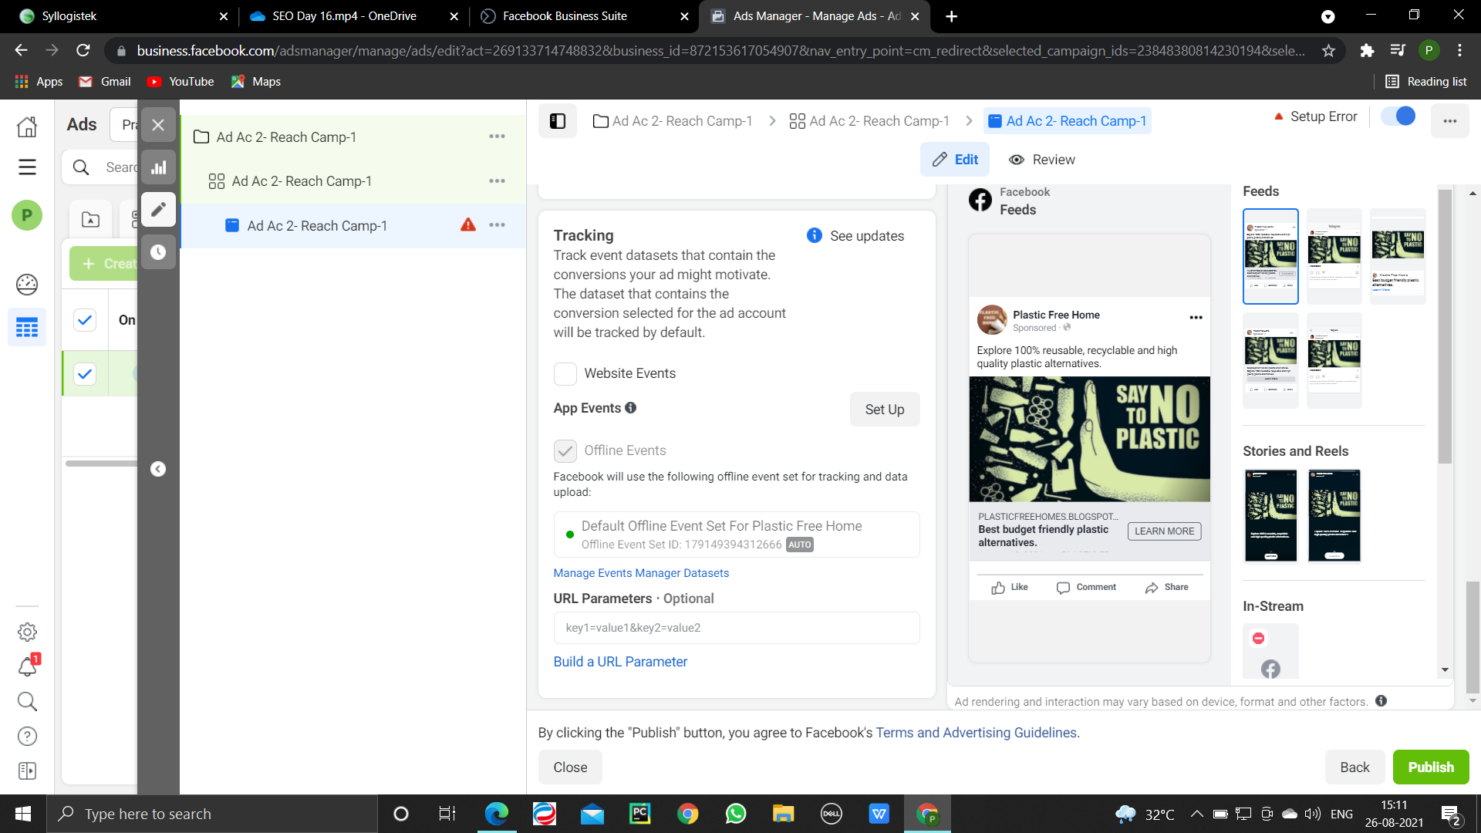

Slide 33
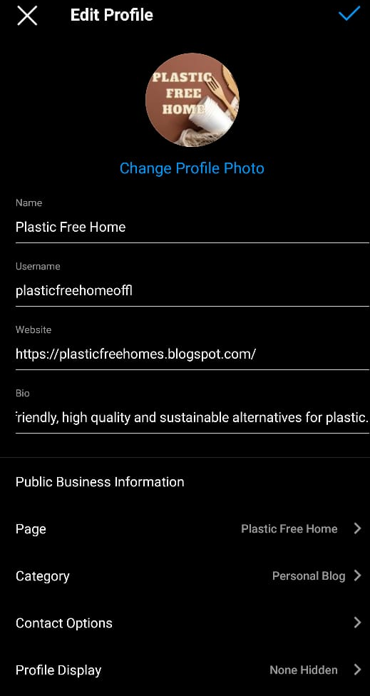
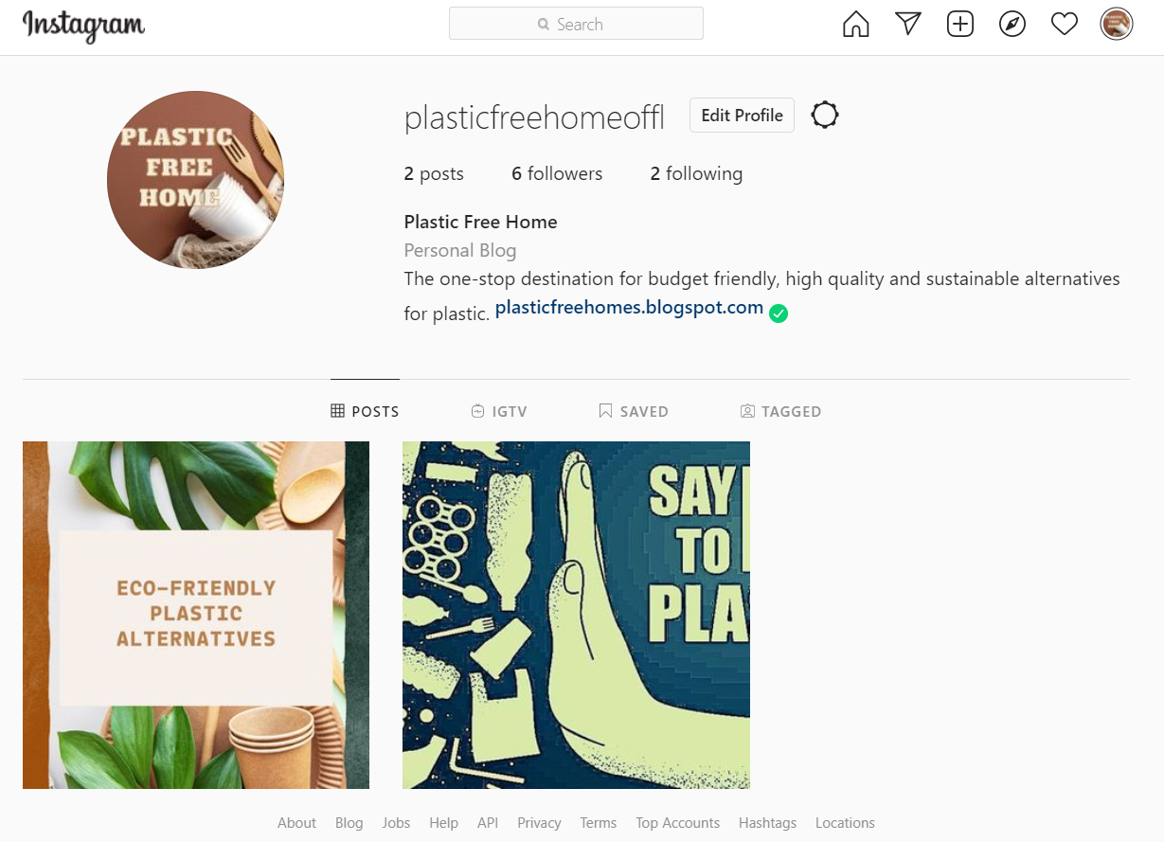
2.INSTAGRAM (https://www.instagram.com/plasticfreehomeoffl/)2

Slide 34
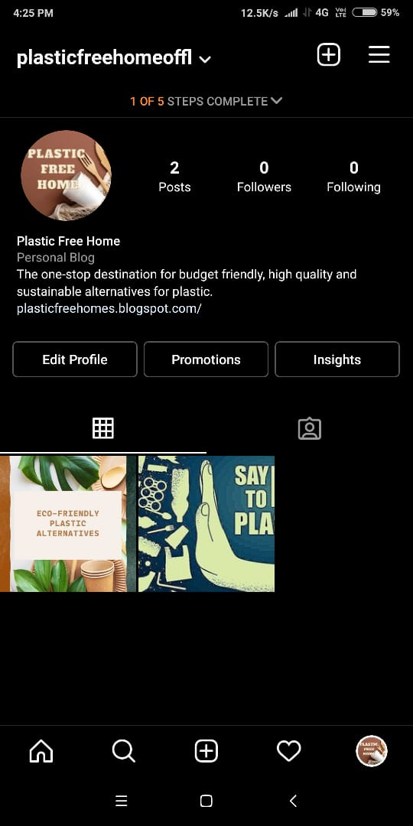
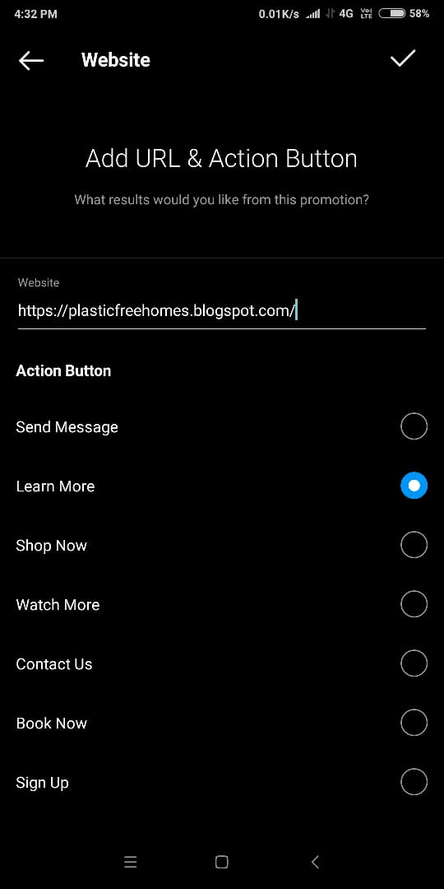
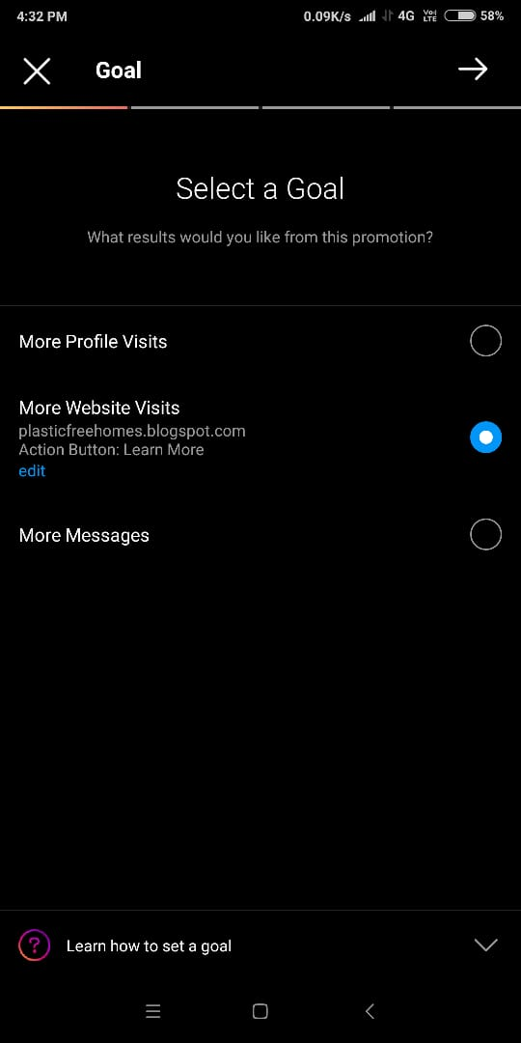
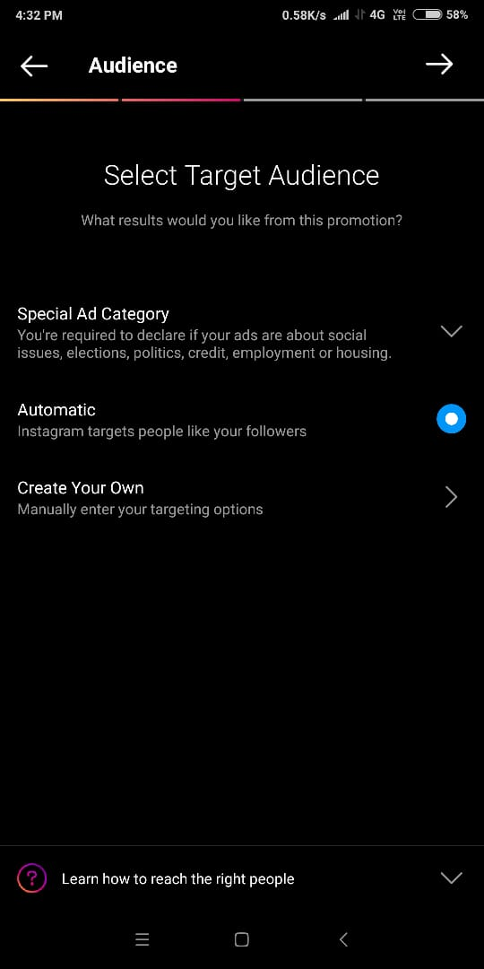
INSTAGRAM CAMPAIGN

Slide 35
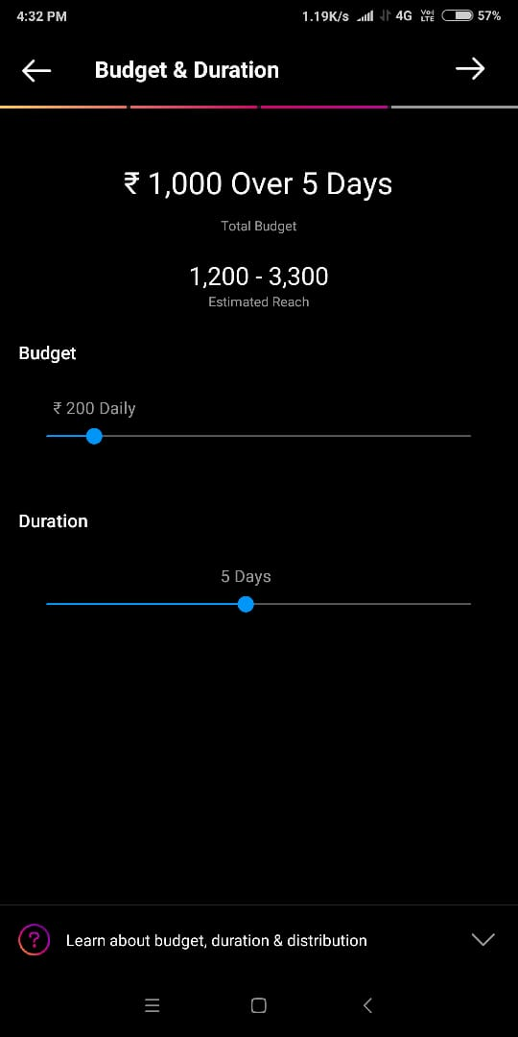
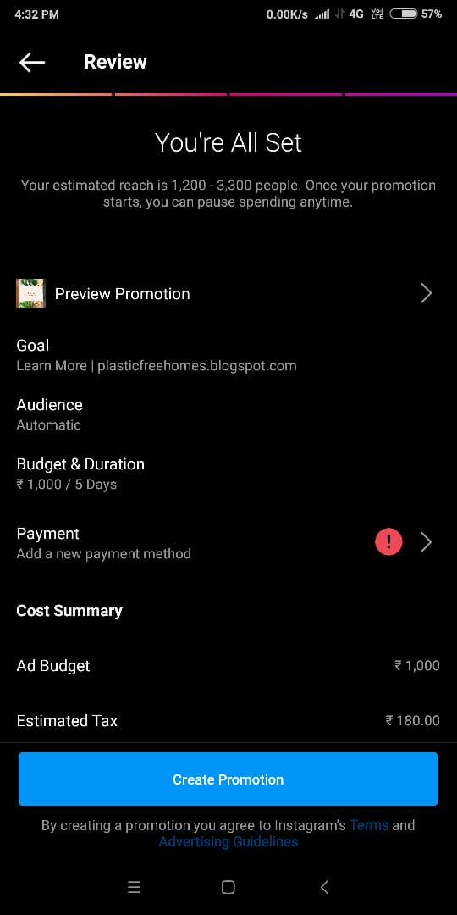
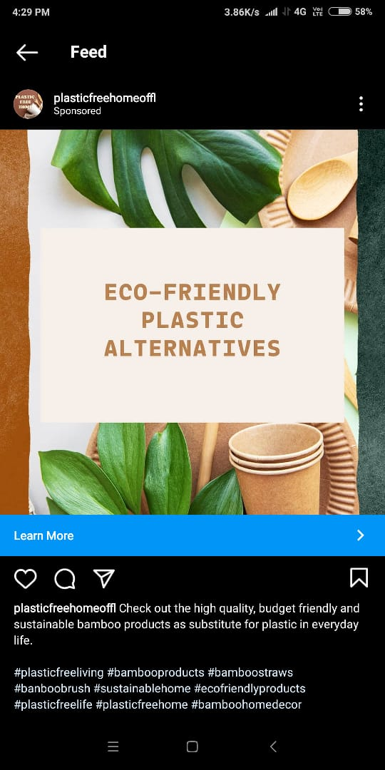

Slide 36
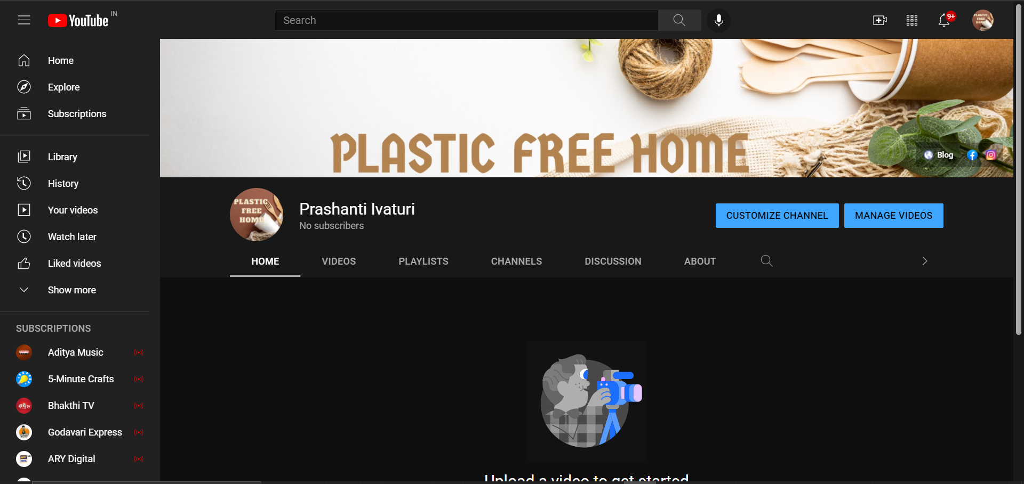
3. YOUTUBE

Slide 37
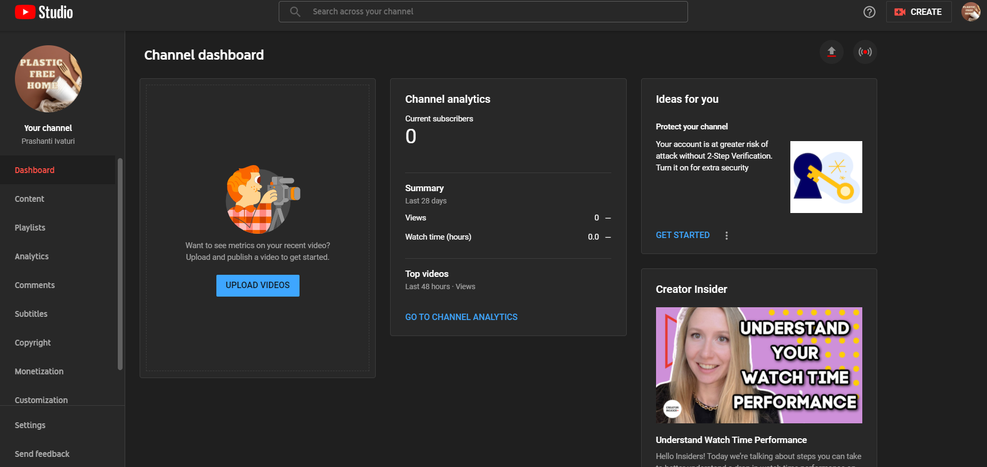

Slide 38
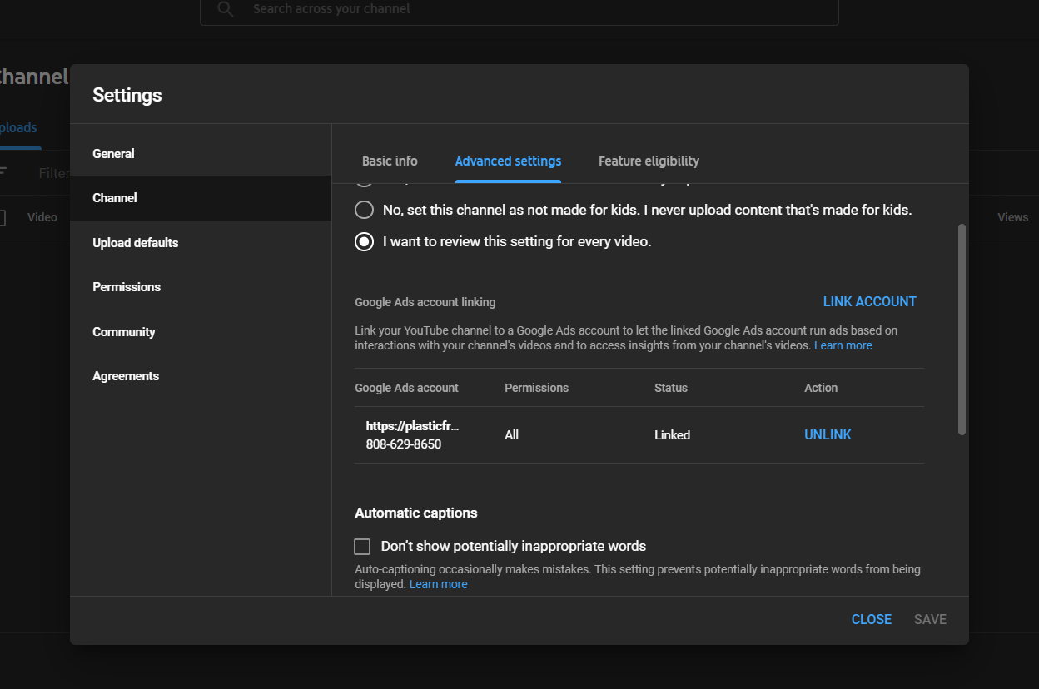

Slide 39
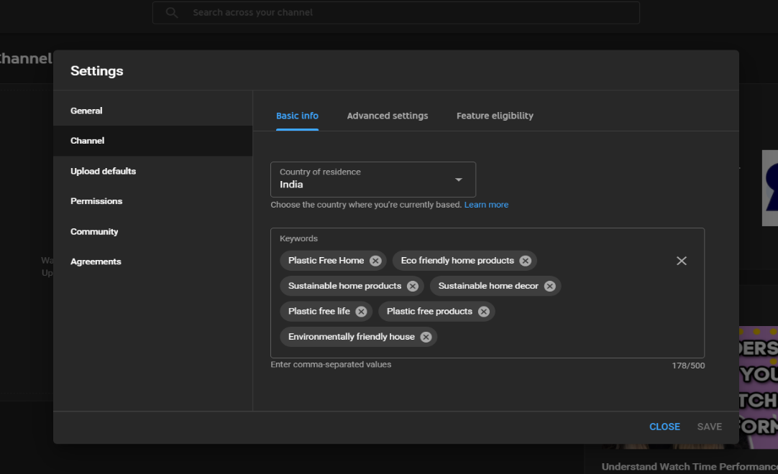
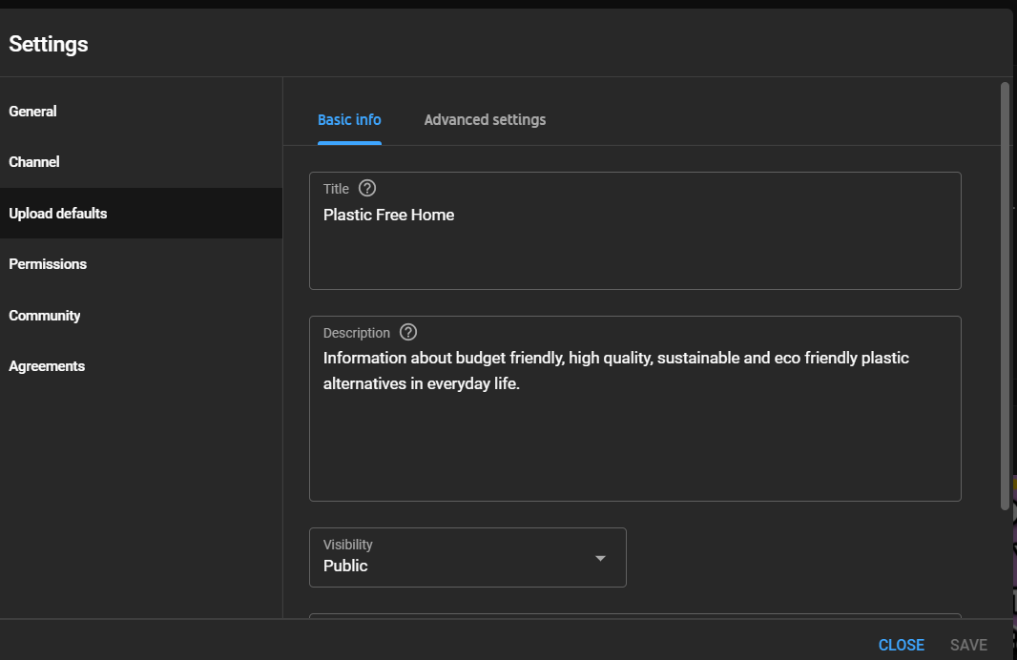

Slide 40
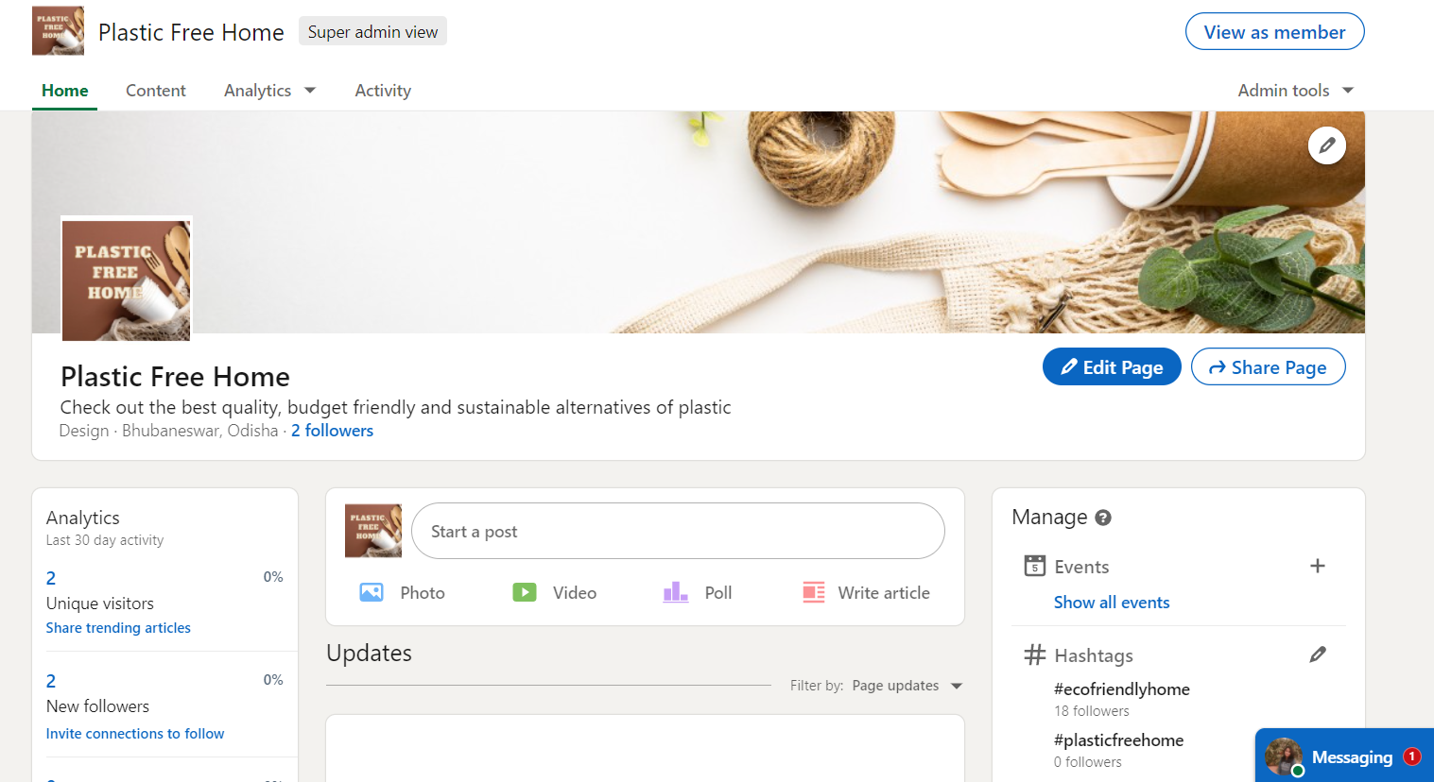
4. LINKEDIN

Slide 41
DIGITAL MARKETING CALENDAR

Slide 42
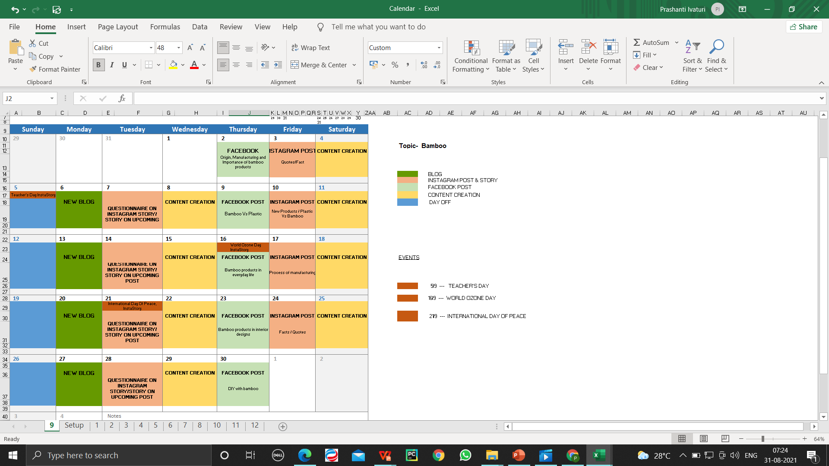
CONTENT CALENDAR

Slide 43
TARGETS

Slide 44
TARGETS
Increase traffic to my blog by at least 50 by October 2021.
Publish more blogs on different topics.
Increase YouTube Subscribers.
Increase Instagram and Facebook followers(70-100) by October 2021.

Slide 45
THANKYOU

